Slide 1
Nurse Survey EDA

Slide 2
Packages
Some Sources:
https://r4ds.had.co.nz/exploratory-data-analysis.html#cat-cont
https://learningstatisticswithr.com/book/chisquare.html
Data Import
# A tibble: 122 x 51 ResponseID Age Race Rel_stat Gen_id Geographic Acad_stat Sex_ori <dbl> <dbl> <fct> <fct> <fct> <fct> <fct> <fct> 1 57260650 20 4 1 2 3 3 1 2 57262669 NA 7 1 2 1 3 1 3 57262726 NA 4 1 2 2 2 1 4 57263988 18 4 1 2 2 1 3 5 57285198 18 4 1 2 2 1 1 6 57294490 NA 3 1 2 1 1 1 7 57299745 27 2 2 2 3 5 1 8 57344567 19 2 1 3 3 2 4 9 57353650 18 2 1 2 1 1 1 10 58055650 18 4 1 2 1 1 2 # ... with 112 more rows, and 43 more variables: Or_VagAnal <fct>, # Age_1stSex <fct>, SexPar_PYr <fct>, CU_lastSex <fct>, SubUse_lastSex <fct>, # CUfreq_Osex <fct>, CUfreq_Vsex <fct>, CUfreq_Asex <fct>, SEXpar_P6mo <fct>, # CU_BFGF <fct>, CUmultisex_oral <fct>, CUmultisex_vag <fct>, # CUmultisex_anal <fct>, CU_OsexFWB <fct>, CU_VsexFWB <fct>, # CU_AsexFWB <fct>, CU_OsexHkup <fct>, CU_VsexHkup <fct>, CU_AsexHkup <fct>, # Respon_CU <fct>, Discuss_CU <fct>, CU_uncomf <fct>, # C_break_slips_unrely <fct>, C_pleasant <fct>, C_dontprotectSTI <fct>, # CU_preventspots <fct>, Prefer_planB <fct>, partnerCU_Noshame <fct>, # CU_intentions <fct>, DoNotlike_C <fct>, Noshame_askCU <fct>, # CU_interuptFlow <fct>, CU_prevPreg0STIs <fct>, raw_sexBetr <fct>, # Preg_STI_worry <fct>, STI_HIVtest <fct>, Pos_STIHIV <fct>, # Freq_STItest <fct>, Last_STItest_A <fct>, UTHC_aware <fct>, # UTHC_serv <fct>, TOT_Sexpart <fct>, SexPart_APP <fct>

Slide 3
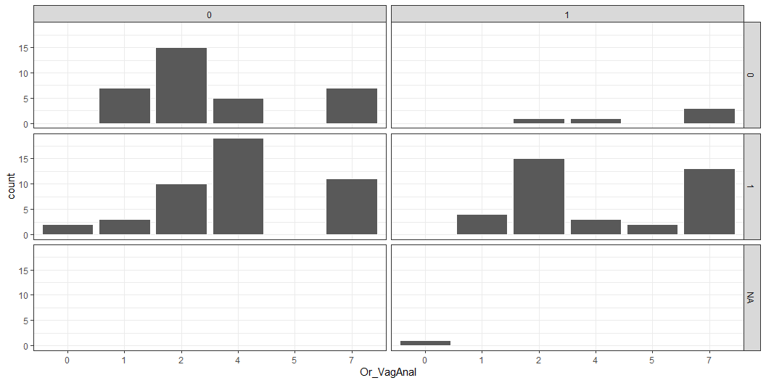
Type of Sex vs. Condom Use vs. Substance Use
# A tibble: 5 x 3 SubUse_lastSex CU_lastSex n <fct> <fct> <int> 1 0 0 34 2 0 1 45 3 1 0 5 4 1 1 37 5 1 <NA> 1

Slide 4
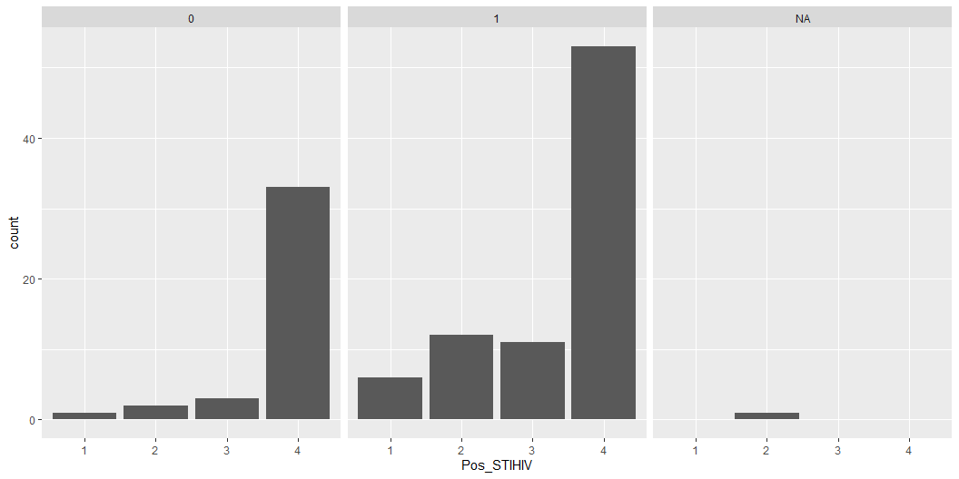
STI vs. Condom
# A tibble: 9 x 3 CU_lastSex Pos_STIHIV n <fct> <fct> <int> 1 0 1 1 2 0 2 2 3 0 3 3 4 0 4 33 5 1 1 6 6 1 2 12 7 1 3 11 8 1 4 53 9 <NA> 2 1

Slide 5
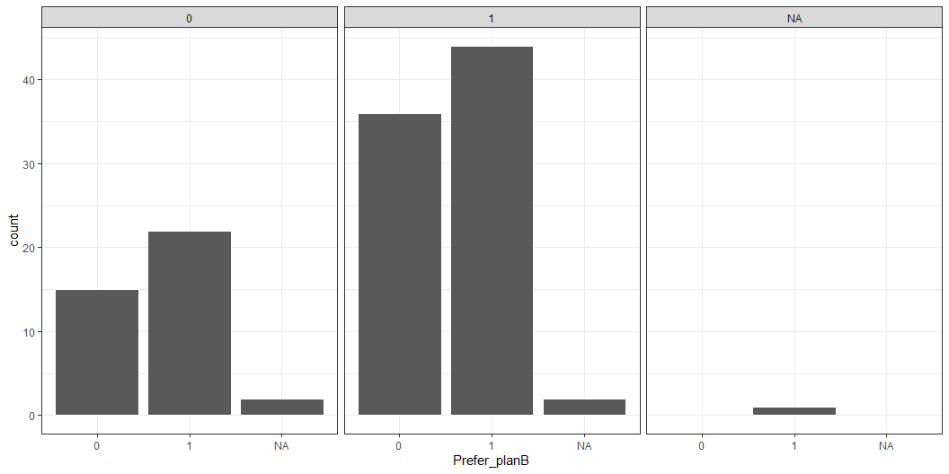
Prefer Plan B vs. Condom
# A tibble: 7 x 3 Prefer_planB CU_lastSex n <fct> <fct> <int> 1 0 0 15 2 0 1 36 3 1 0 22 4 1 1 44 5 1 <NA> 1 6 <NA> 0 2 7 <NA> 1 2

Slide 6
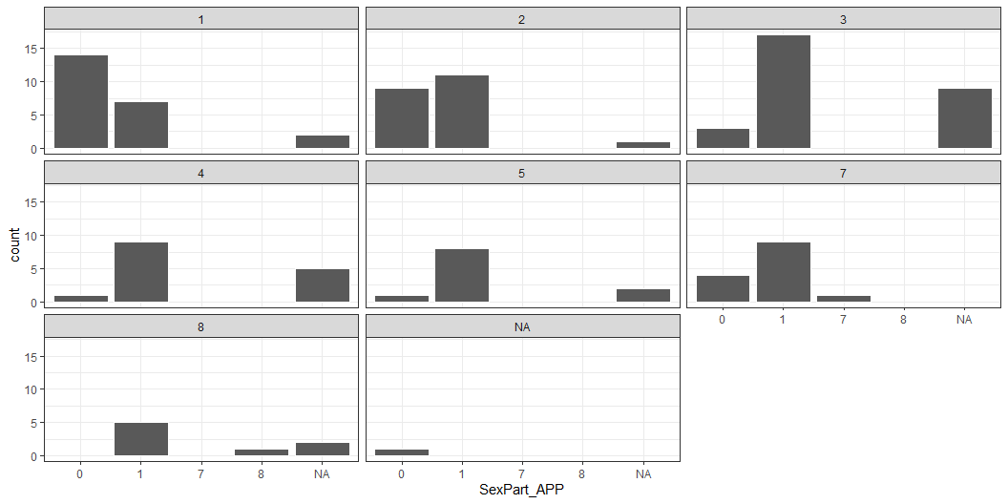
# A tibble: 22 x 3 TOT_Sexpart SexPart_APP n <fct> <fct> <int> 1 1 0 14 2 1 1 7 3 1 <NA> 2 4 2 0 9 5 2 1 11 6 2 <NA> 1 7 3 0 3 8 3 1 17 9 3 <NA> 9 10 4 0 1 # ... with 12 more rows

Slide 7
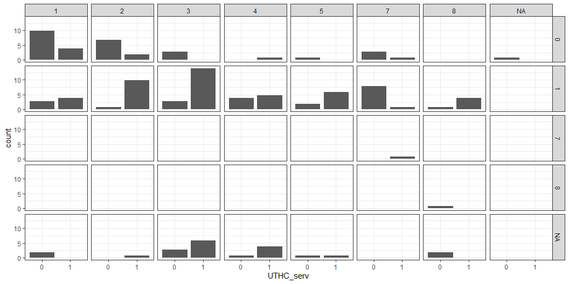
UT Services vs Sex Partners vs. App Sex Partners
# A tibble: 35 x 4 UTHC_serv SexPart_APP TOT_Sexpart n <fct> <fct> <fct> <int> 1 0 0 1 10 2 0 0 2 7 3 0 0 3 3 4 0 0 5 1 5 0 0 7 3 6 0 0 <NA> 1 7 0 1 1 3 8 0 1 2 1 9 0 1 3 3 10 0 1 4 4 # ... with 25 more rows

Slide 8
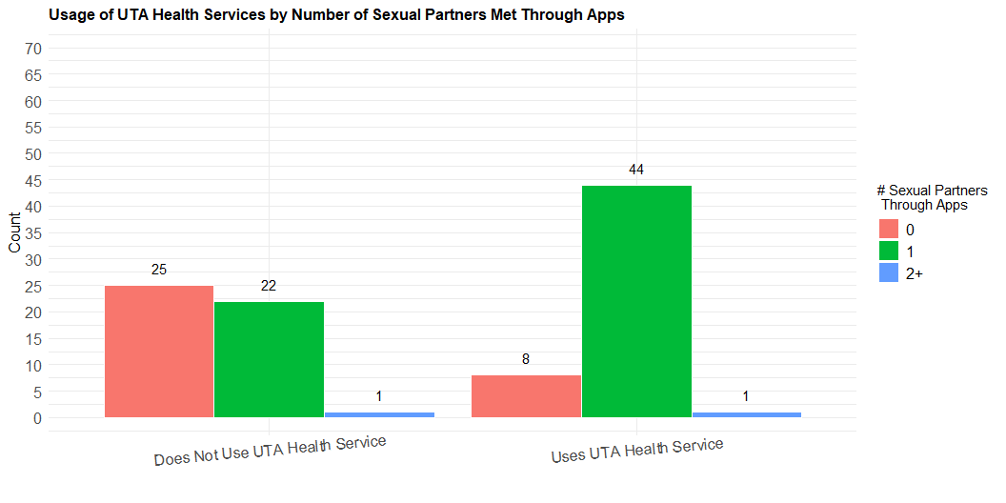
UT Health Services vs. Sexual Partners on App
# A tibble: 6 x 3 UTHC_serv sexpartapp n <fct> <chr> <int> 1 0 0 18 2 0 1 21 3 0 2+ 1 4 1 0 5 5 1 1 34 6 1 2+ 1

Slide 9
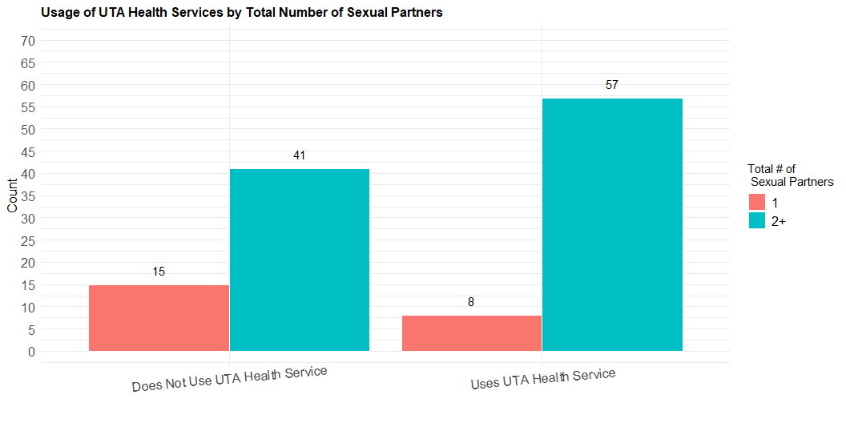
UT Health Services vs. Total Partners on App
# A tibble: 4 x 3 UTHC_serv sexparttot n <fct> <chr> <int> 1 0 1 15 2 0 2+ 41 3 1 1 8 4 1 2+ 57

Slide 10
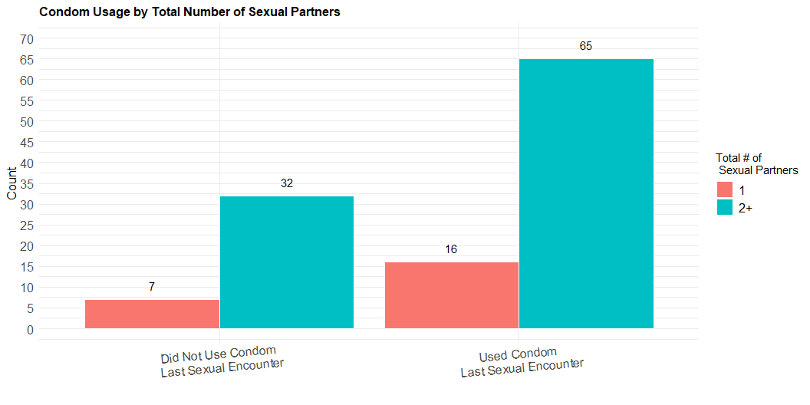
Condom Use vs. Sexual Partners
Condom Use vs. Total Sexual Partners
# A tibble: 4 x 3 CU_lastSex sexparttot n <fct> <chr> <int> 1 0 1 7 2 0 2+ 32 3 1 1 16 4 1 2+ 65

Slide 11
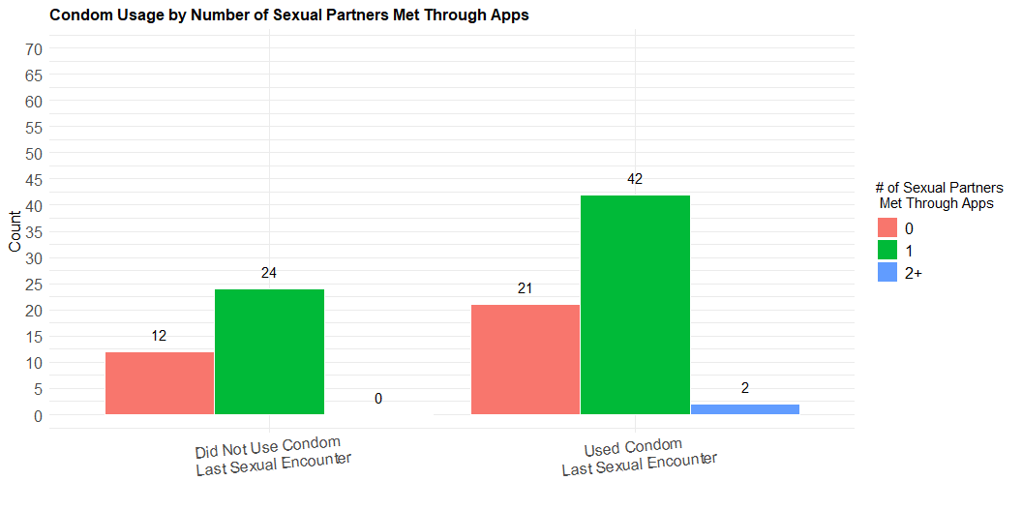
Condom Use vs. App Sexual Parnters
# A tibble: 5 x 3 CU_lastSex sexpartapp n <fct> <chr> <int> 1 0 0 12 2 0 1 24 3 1 0 21 4 1 1 42 5 1 2+ 2

Slide 12
Graphs

Slide 16
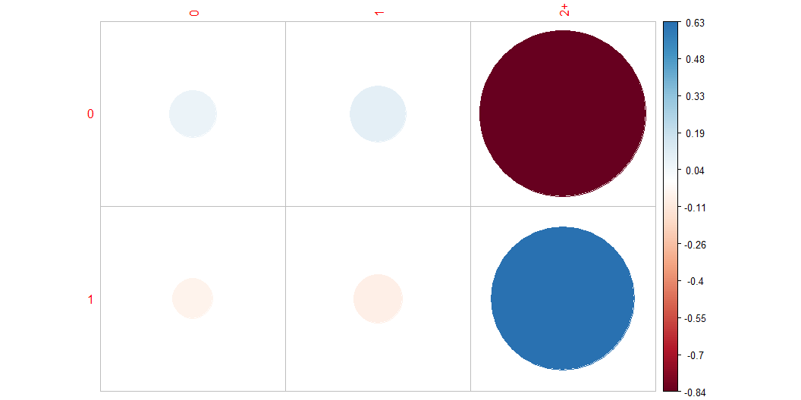
Chi Squared Tests: Condom Use vs. App Sexual Partners
# A tibble: 5 x 3 CU_lastSex sexpartapp n <dbl> <chr> <int> 1 0 0 12 2 0 1 24 3 1 0 21 4 1 1 42 5 1 2+ 2
0 1 2+ 0 12 24 0 1 21 42 2
0 1 7 8 0 12 24 0 0 1 21 42 1 1
Pearson's Chi-squared test data: data_cuapp X-squared = 1.1301, df = 2, p-value = 0.5683
0 1 2+ 0 12 24 0 1 21 42 2
0 1 2+ 0 11.76 23.52 0.71 1 21.24 42.48 1.29
[1] "Crtical Value of 95% Chi Square with 2 DOF:"
[1] 7.377759
The chisq test returns:
Statistic: the value the chi-squared test statistic. parameter: the degrees of freedom p.value: the p-value of the test observed: the observed count expected: the expected count
P value less than 0.05 and a chi-squared value higher than the critical value reject null hypothesis that there is no relationship.
Sources:
http://www.sthda.com/english/wiki/chi-square-goodness-of-fit-test-in-r http://www.sthda.com/english/wiki/wiki.php?title=chi-square-test-of-independence-in-r

Slide 17
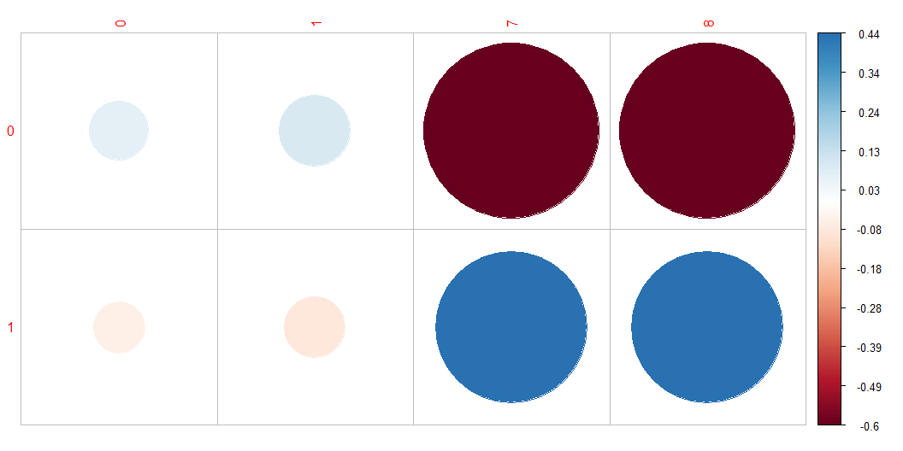

Slide 18
Positive residuals are in blue.
Positive values in cells specify an attraction (positive association) between the corresponding row and column variables.
Negative residuals are in red.
This implies a repulsion (negative association) between the corresponding row and column variables.

Slide 19
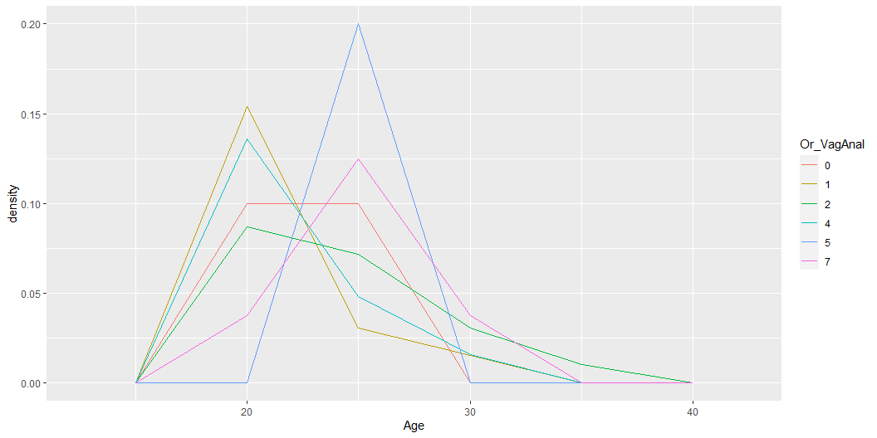
Z Proportion and Chi Squared Tests: UT Health Services vs. Total Partners
Note that, for 2 x 2 table, the standard chi-square test in chisq.test() is exactly equivalent to prop.test() but it works with data in matrix form.
Source:
http://www.sthda.com/english/wiki/two-proportions-z-test-in-r
1 2+ 0 15 41 1 8 57
Shows that the proportion test for a 2 x 2 table is the same as a Pearson Chi Squared Test
2-sample test for equality of proportions with continuity correction data: as.matrix(data_hctot) X-squared = 3.2095, df = 1, p-value = 0.07321 alternative hypothesis: two.sided 95 percent confidence interval: -0.01266383 0.30222427 sample estimates: prop 1 prop 2 0.2678571 0.1230769
Pearson's Chi-squared test with Yates' continuity correction data: data_hctot X-squared = 3.2095, df = 1, p-value = 0.07321
Type of Sex vs. Race, Age, and More EDA Plots
# A tibble: 27 x 3 Or_VagAnal Race n <fct> <fct> <int> 1 0 2 1 2 0 4 1 3 0 7 1 4 1 1 2 5 1 2 3 6 1 3 3 7 1 4 2 8 1 5 1 9 1 7 3 10 2 1 8 # ... with 17 more rows

Slide 20
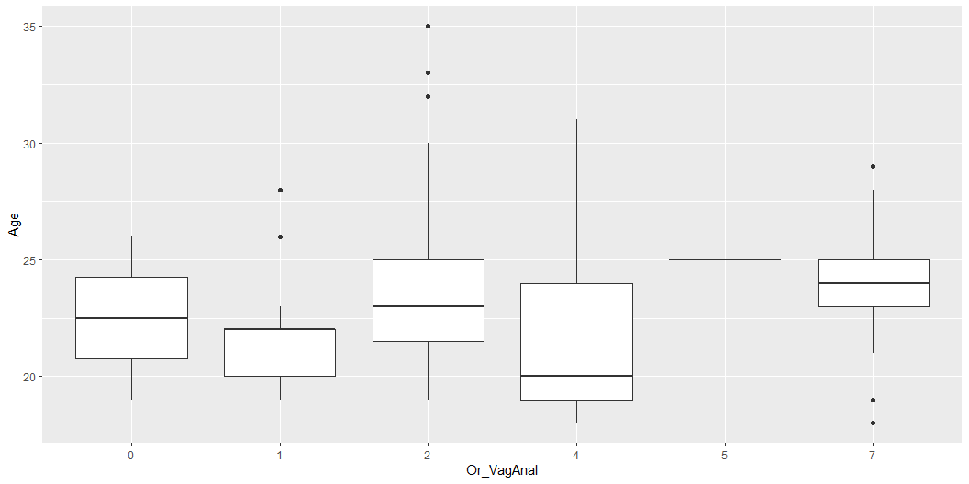

Slide 21
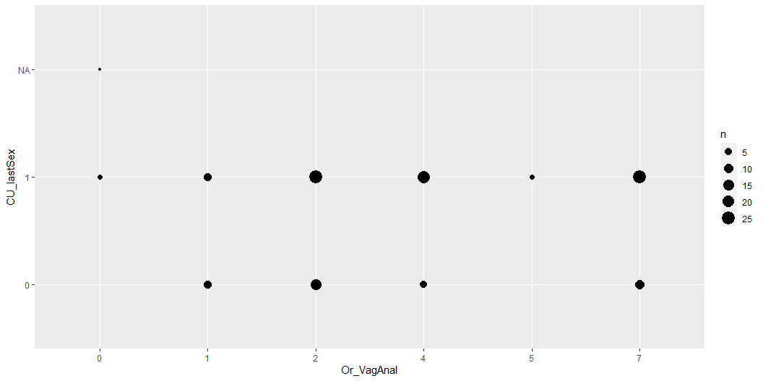

Slide 22
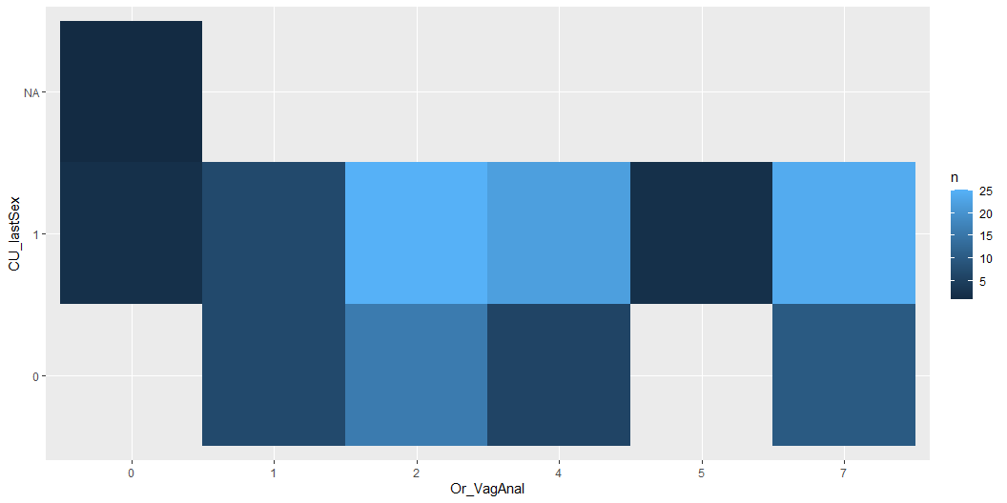

Slide 23
